Slide 1



End to End SQL Data Warehousing to Customer Analytics Report
By Harsha Vardhan Kuppili GitHub-Repository
Harsha.vardhan897@gmail.com
LinkedIn
Mobile : 0466602261

Slide 2
Agenda:
Executive Summary
Data Modelling (Medallion Architecture → Star Schema)
Problem Statement
PowerBI Report
Key Findings & Insights (PowerBI Report)
Strategic Recommendations

Slide 3


Executive Summary
Built a unified data platform using SQL as the foundation
Modernized scattered CRM/ERP files into a structured pipeline (DDL, DML, CTEs, Window Functions) with automated ingestion and quality checks via stored procedures.
Created a trusted semantic layer through Gold Views
Standardized, validated, and deduped data in Silver, then exposed clean analytic models (dim_customer, dim_product, fact_sales) as the single source of truth.
Delivered an intelligent Power BI layer with meaningful business signals
Implemented DAX-driven KPIs like Revenue per Customer, CLV enabled by a dedicated Date Table for accurate time intelligence and leadership-level insights.
Tools Used
PostgreSQL: DDL, DML, CTEs, Window Functions, Stored Procedures. Power BI: DAX, Time Intelligence, Semantic Modelling.
Published the complete SQL warehouse + Power BI dashboards in GitHub
SQL-CODE & PowerBI Report

Slide 4
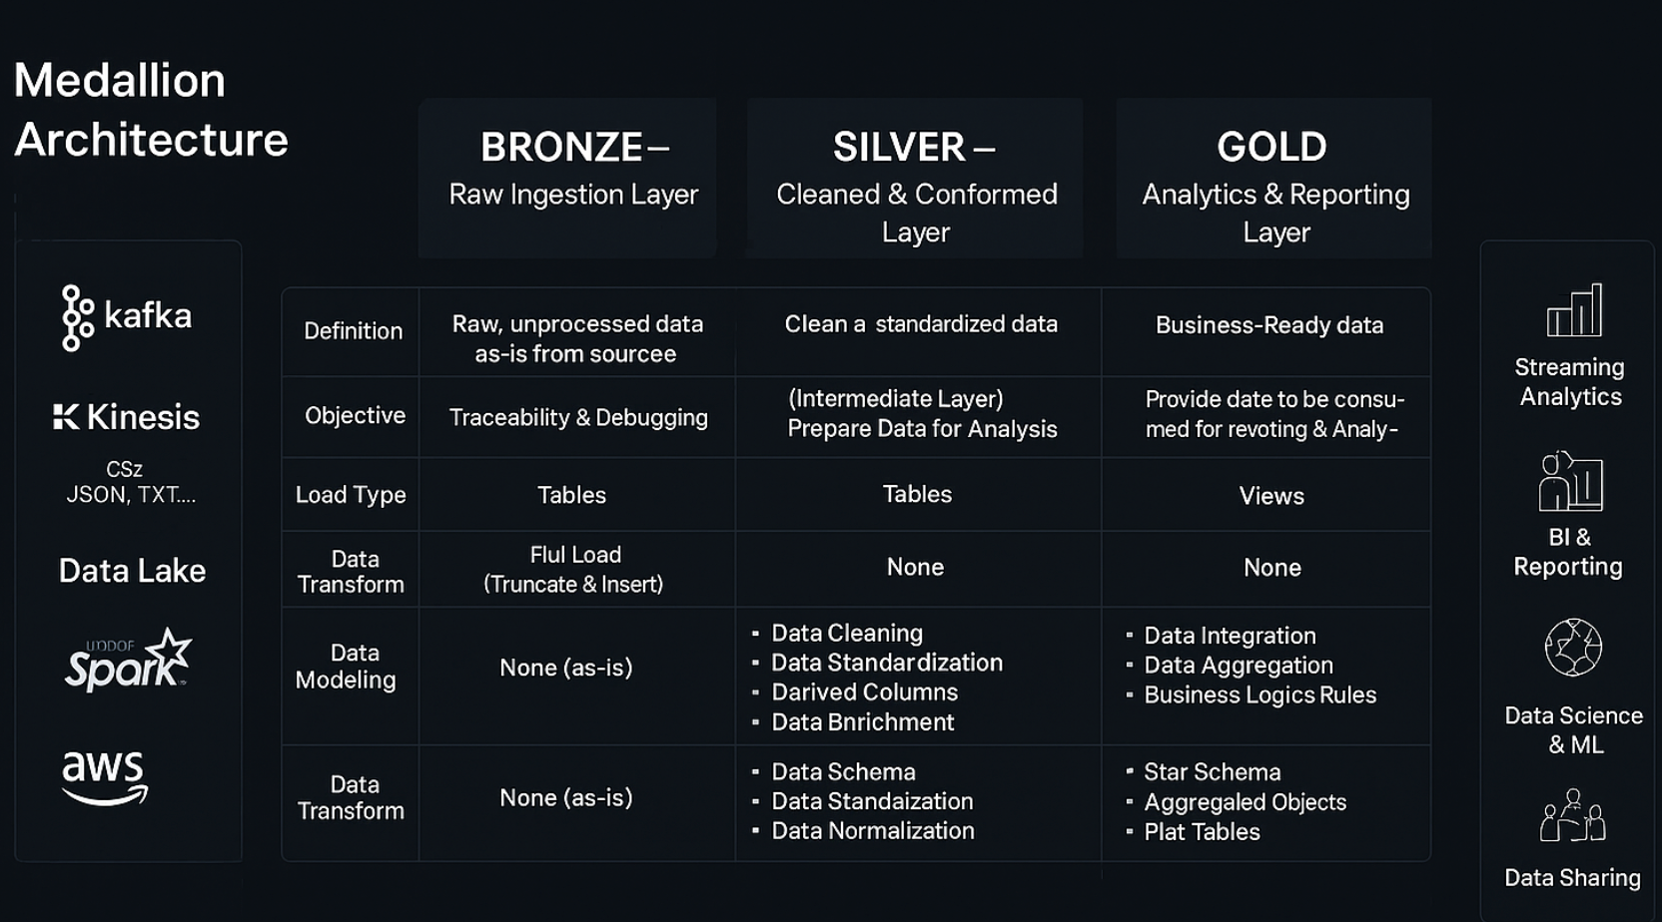
Data Warehousing

Slide 5

“I didn’t build a dashboard for visualization. I built a decision system for leadership.”
Every visual in this report answers a board-level question:
How would our story change if a key metric dropped 50% tomorrow?
What action should we take next?”
Expose geographic & category concentration risks
What insights will help the CEO understand the business in 30 seconds?
If we could track only ONE metric… which one?

Slide 6
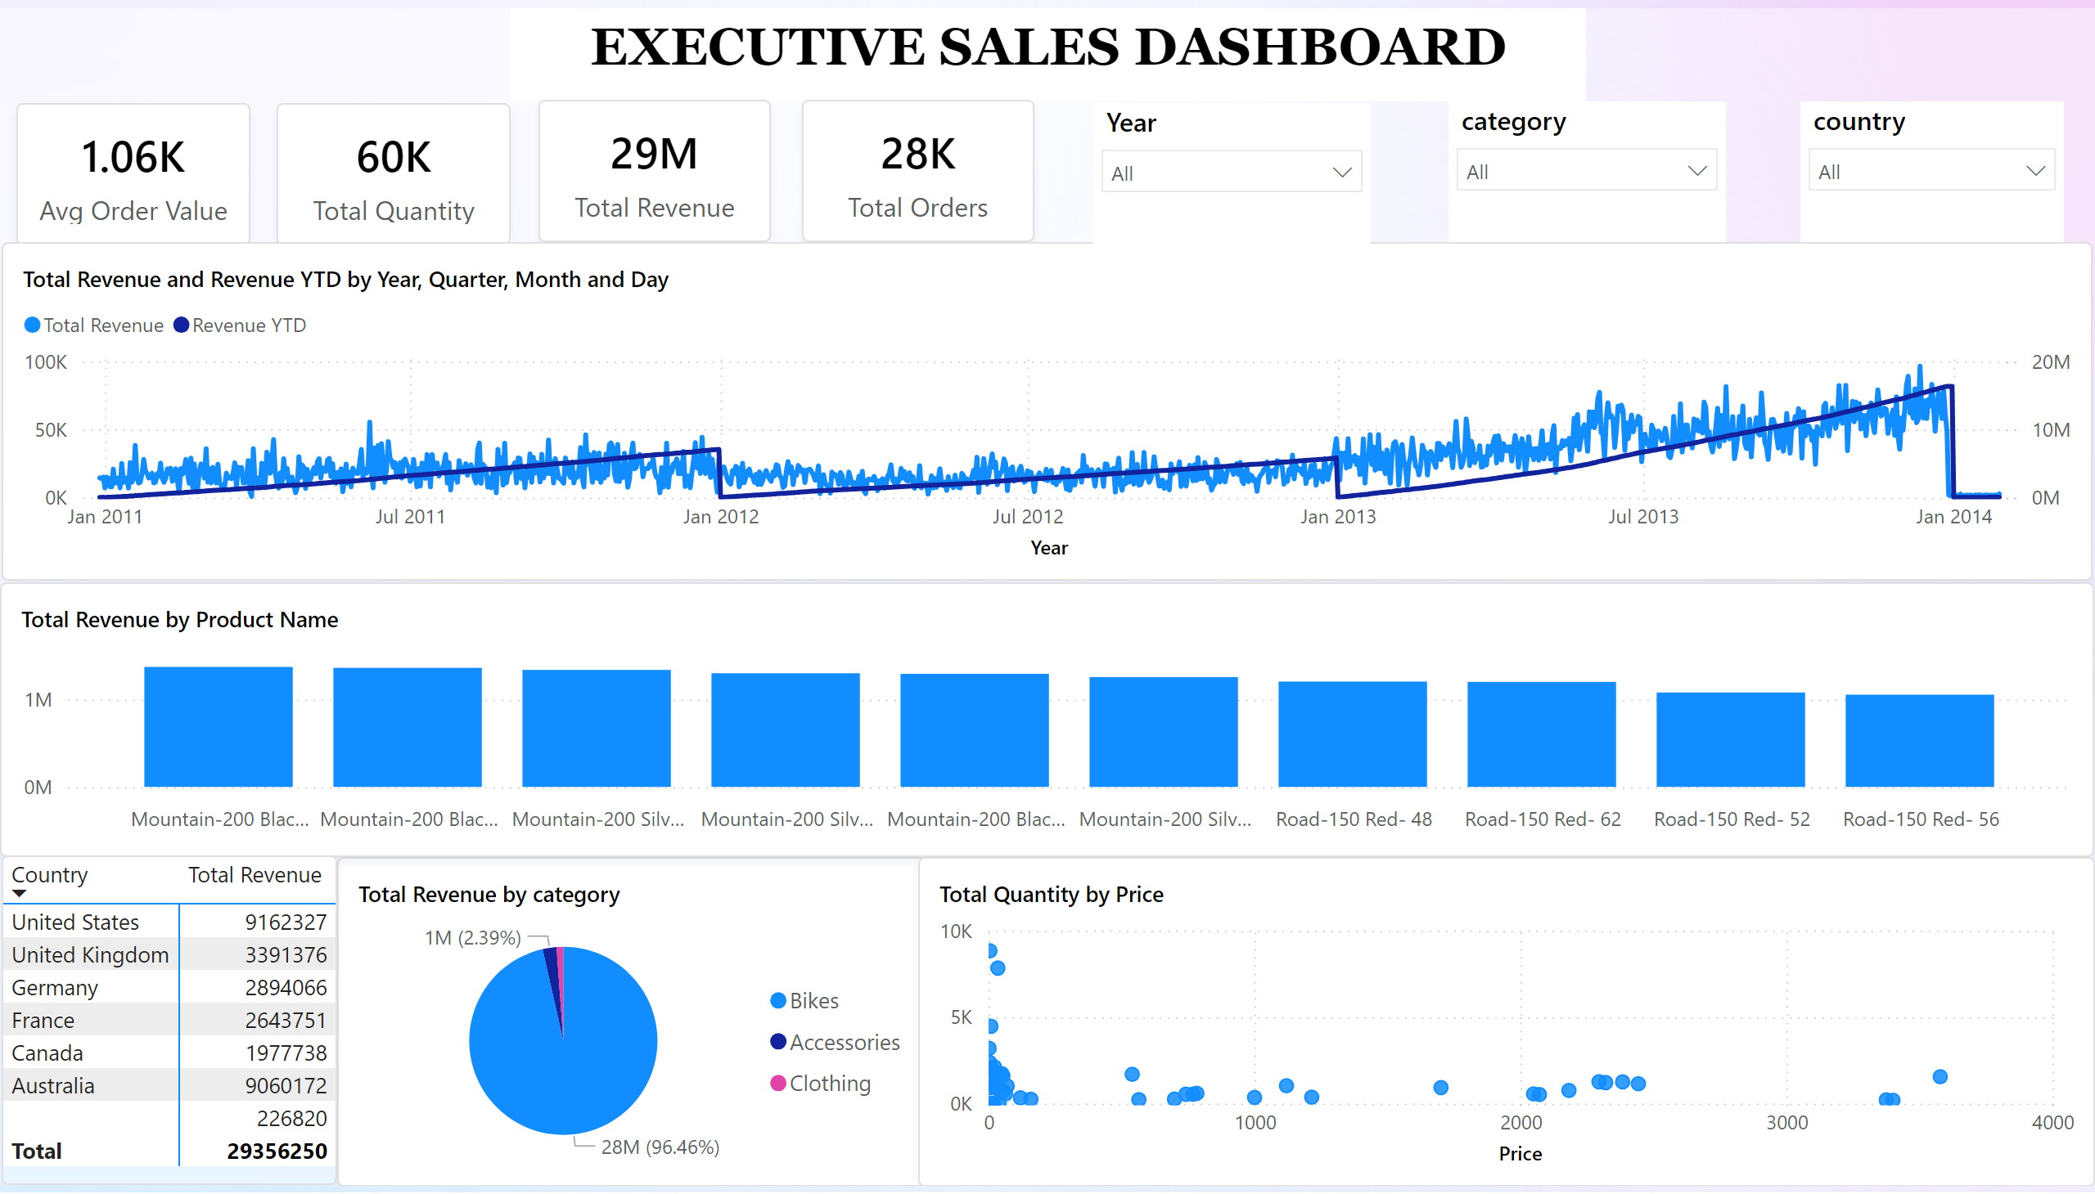
Executive Sales Dashboard
Notes:
slicer
No alt text provided
slicer
No alt text provided
slicer
No alt text provided
Revenue By Country
No alt text provided
scatterChart
No alt text provided
clusteredColumnChart
No alt text provided
pieChart
No alt text provided
lineChart
No alt text provided
card
No alt text provided
card
No alt text provided
card
No alt text provided
card
No alt text provided
textbox
No alt text provided

Slide 7
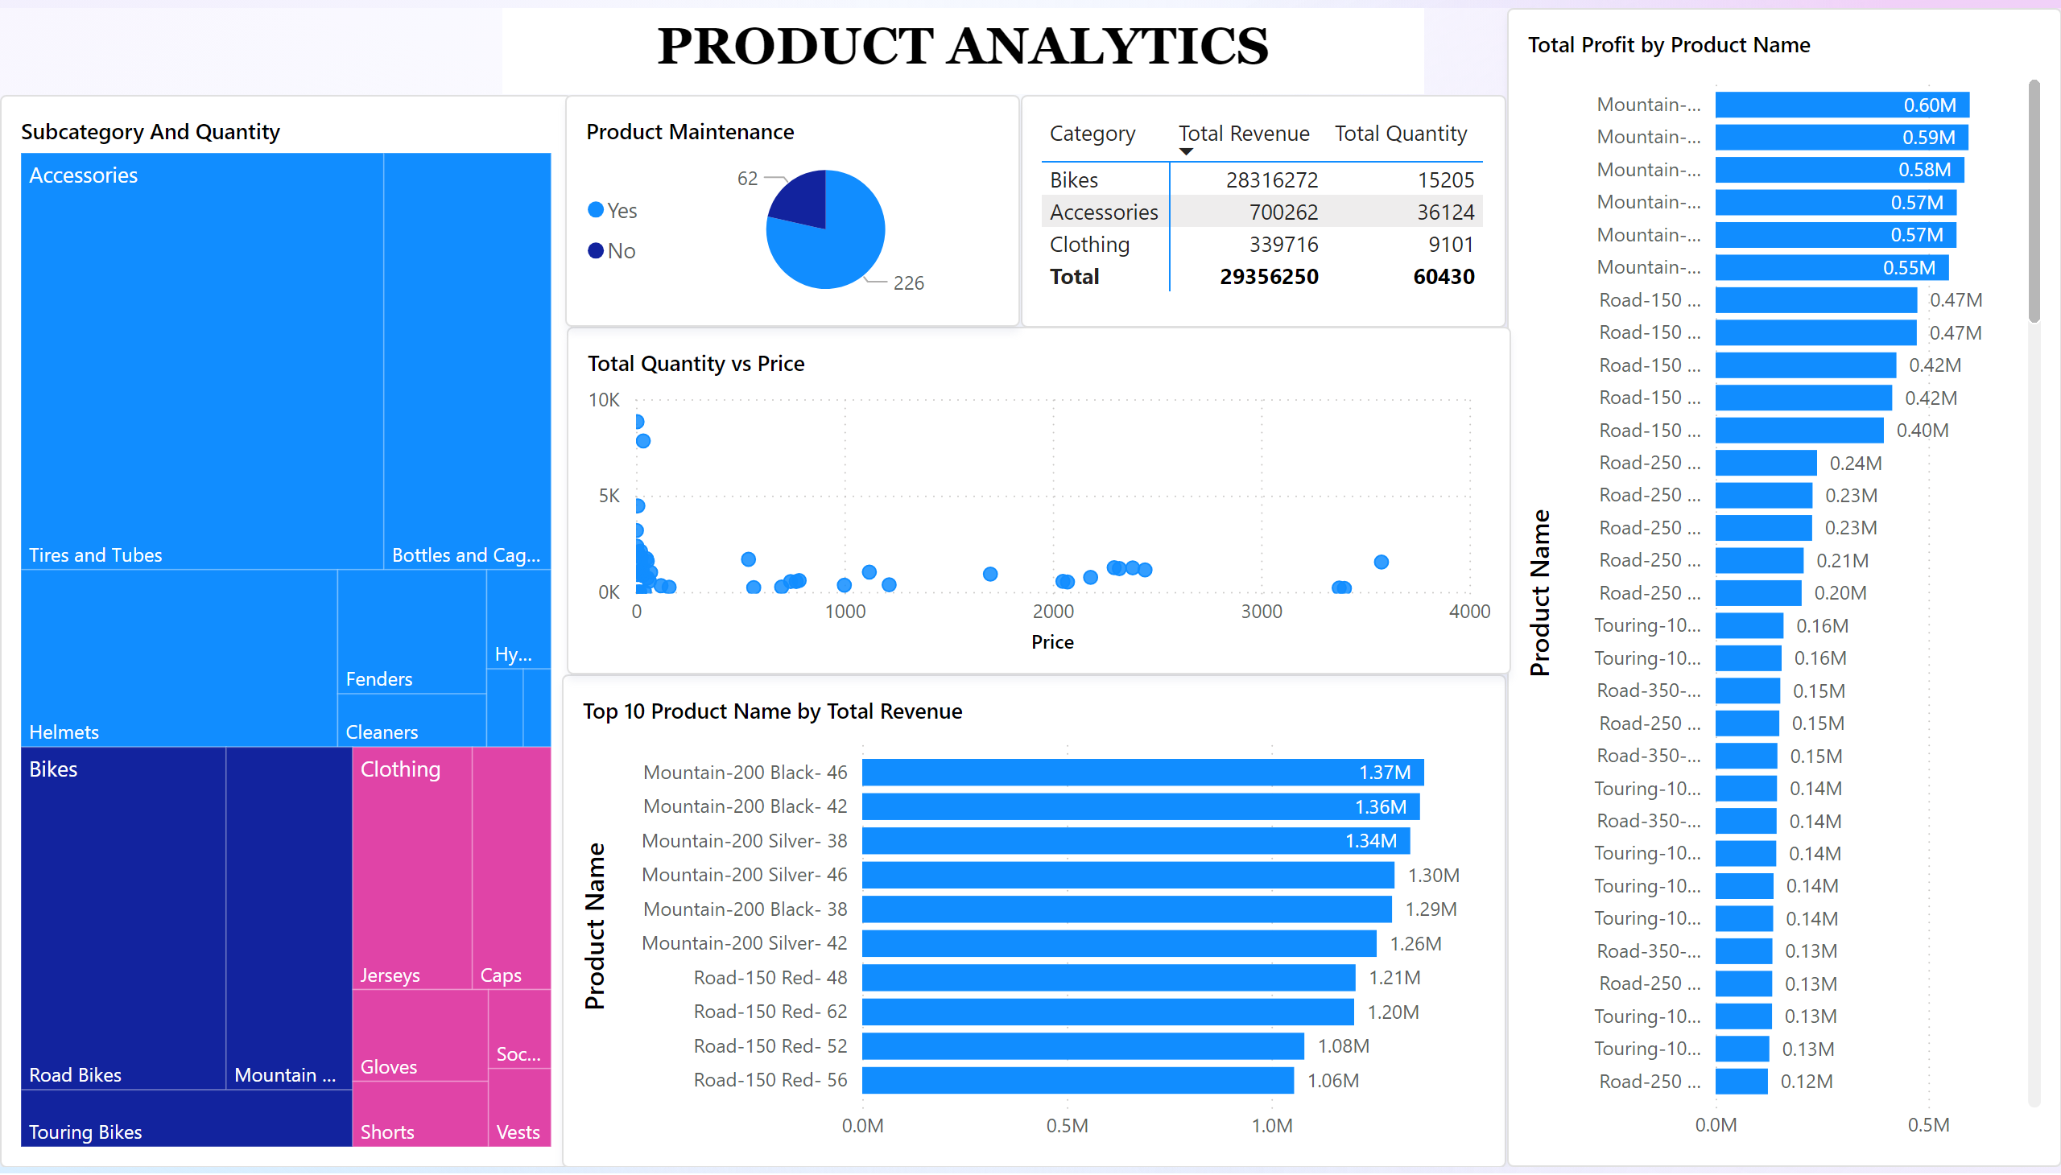
Product Analytics
Notes:
textbox
No alt text provided
Product Maintenance
No alt text provided
Total Quantity vs Price
No alt text provided
clusteredBarChart
No alt text provided
Top 10 Product Name by Total Revenue
No alt text provided
Subcategory And Quantity
No alt text provided
Category Performance
No alt text provided

Slide 8
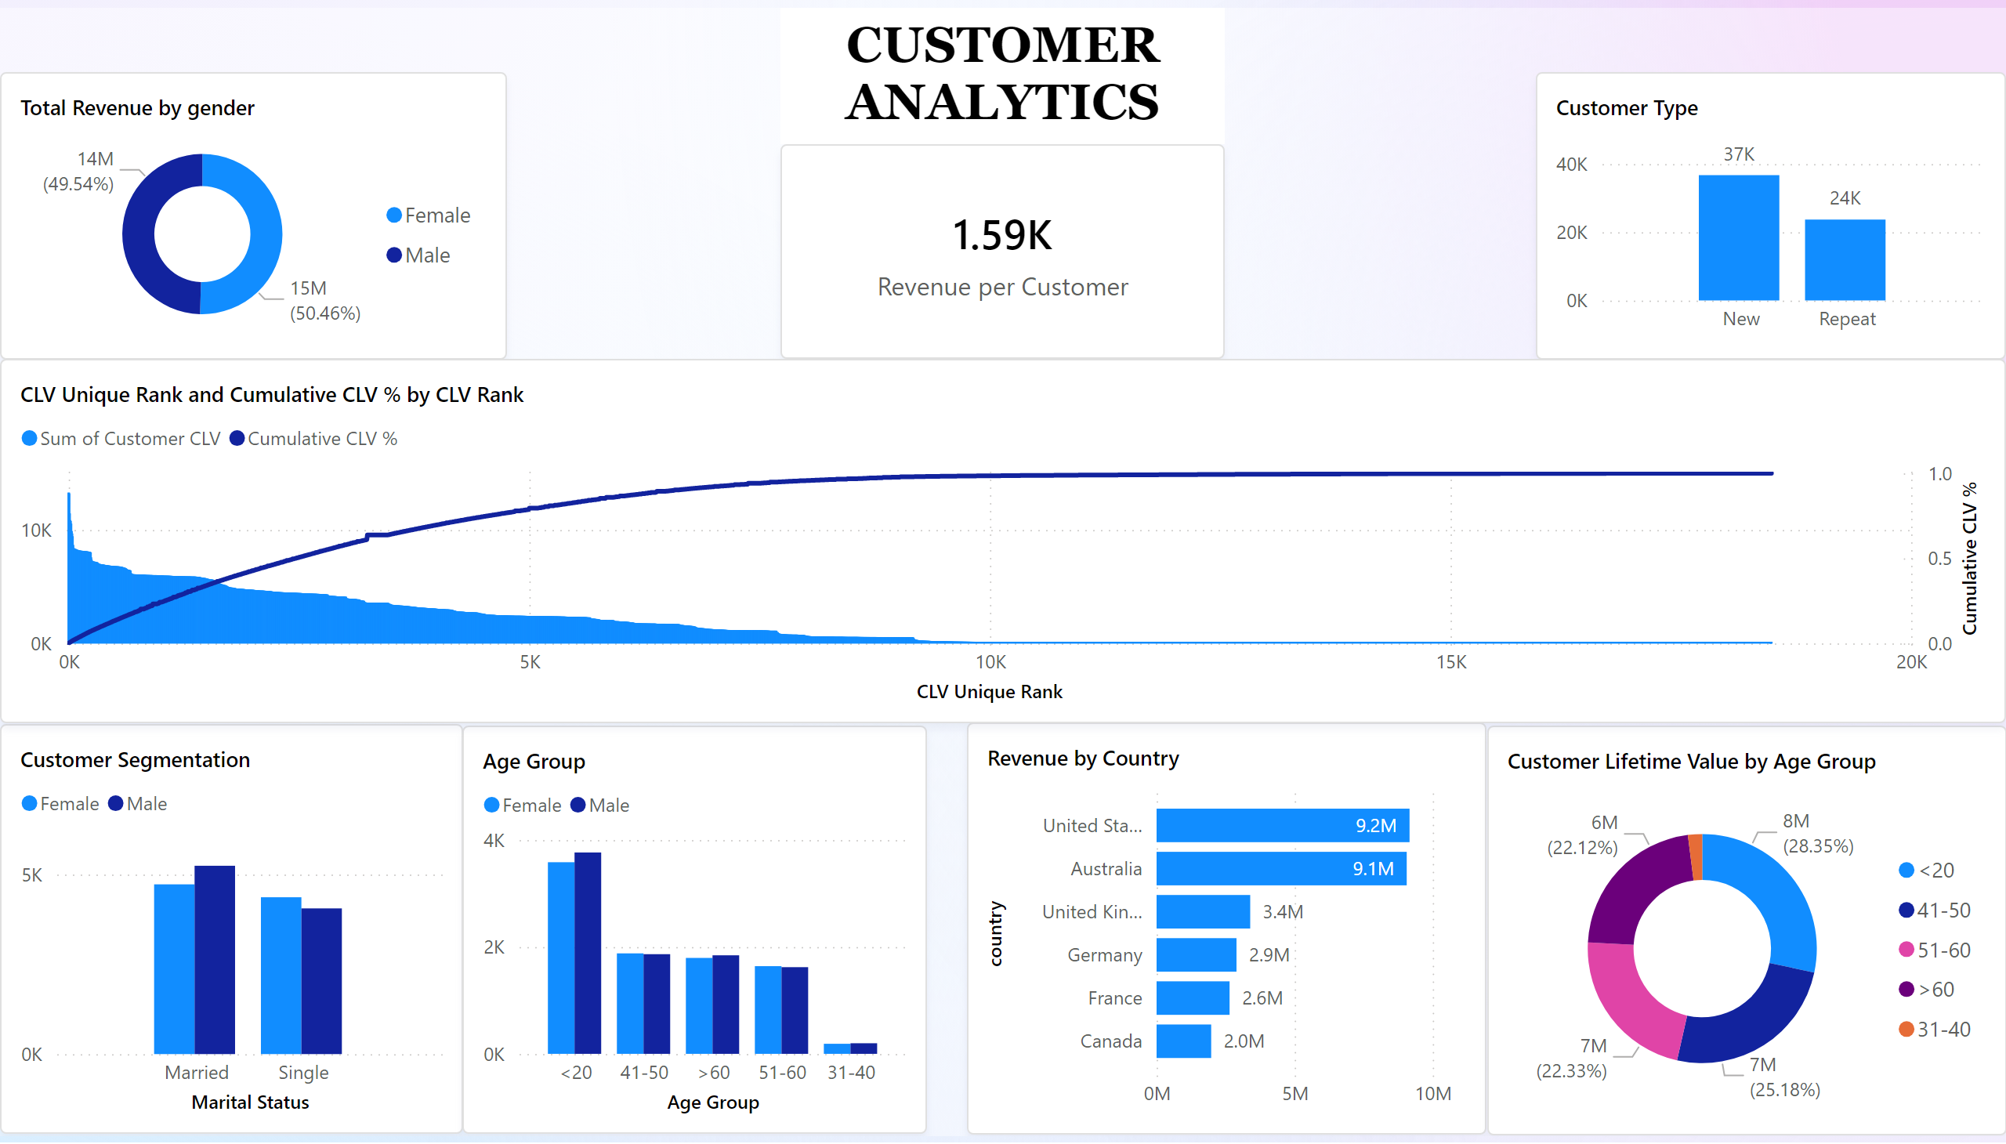
Customer Analytics
Notes:
Customer Type
No alt text provided
Customer Lifetime Value by Age Group
No alt text provided
CLV Unique Rank and Cumulative CLV % by CLV Rank
No alt text provided
Customer Segmentation
No alt text provided
Age Group
No alt text provided
Revenue by Country
No alt text provided
card
No alt text provided
donutChart
No alt text provided
textbox
No alt text provided

Slide 9
Strategic Recommendation
“Remove single points of failure, expand where others are slow, raise prices where the data says you can, and build systems that improve themselves.”
Target Customer Segments With Highest Predictive Value:
If age, gender, and country are strong predictors of revenue, tailor interventions to maximize CLV.
Visual : Customer Segmentation
Optimize Pricing Using Data Instead of Intuition:
Price elasticity is learnable from data. The scatterplot shows a weak negative correlation, meaning price hikes on premium tiers will not reduce demand
Visual : Price vs Quantity
Target Customer Segments With Highest Predictive Value:
If age, gender, and country are strong predictors of revenue, tailor interventions to maximize CLV.
Visual : Customer Segmentation

Slide 10
THANK YOU

